Slide 1
MLB Game Winner Predictor
UCSD Data Science Bootcamp Project 1, 01/11/2020
Alexis Perumal
Venkateswarlu Pinnika
Young You

Slide 2
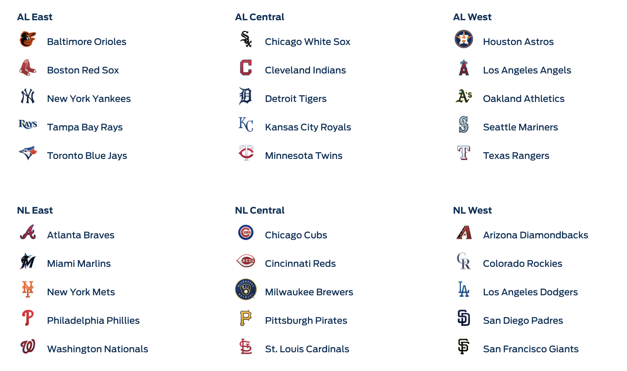
MLB
American League
National League
162 games for each of the 30 teams
played over approximately six months
a total of 2,430 games, plus the postseason

Slide 3
Project Objective
Build a predictor for the winner of baseball games (visitor or home)
with > 50% prediction accuracy, with statistical accuracy.
Analysis will be done by season,
looking at all the regular season games of a given year
with each days' game predicted based on info up to,
but not including that day.

Slide 4
Strategy
Build a dataframe of games (rows) and factors to build a regression model for visiting net points, and by extension, predict the winner of each game (visitor or home).
Explore candidate factors with regression analysis (T-stat, F-stat, p-value) build
optimize a simple LSR model using a training set through the 2017 Season.
Plot the results.
Ultimately, apply the model to the 2018, then 2019 seasons.
Datasets used:
SeanLahman.com
-provides rich baseball game outcome for every MLB game going back to 1881.
-It includes game outcomes, player data, at bats, pitches.
-It is available as a CSV file

Slide 5
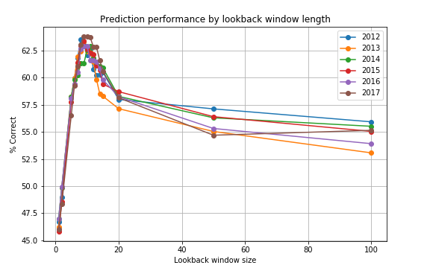
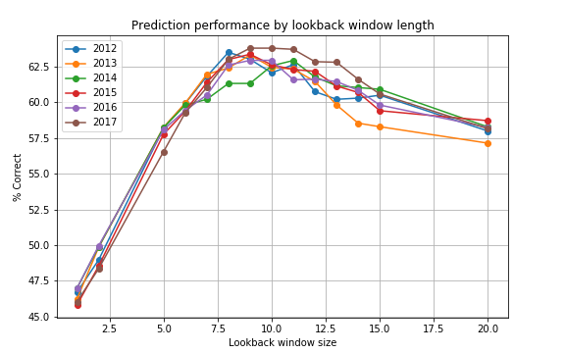
Prediction Performance by Lookback Window Length
day
day

Slide 6
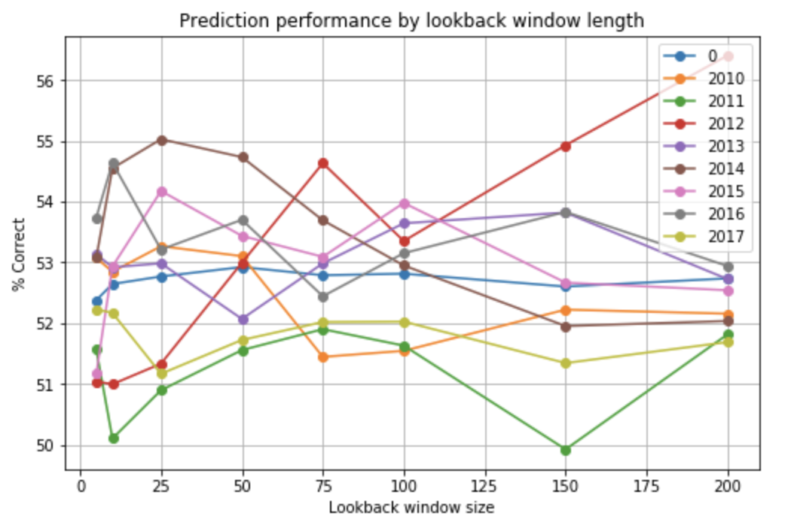
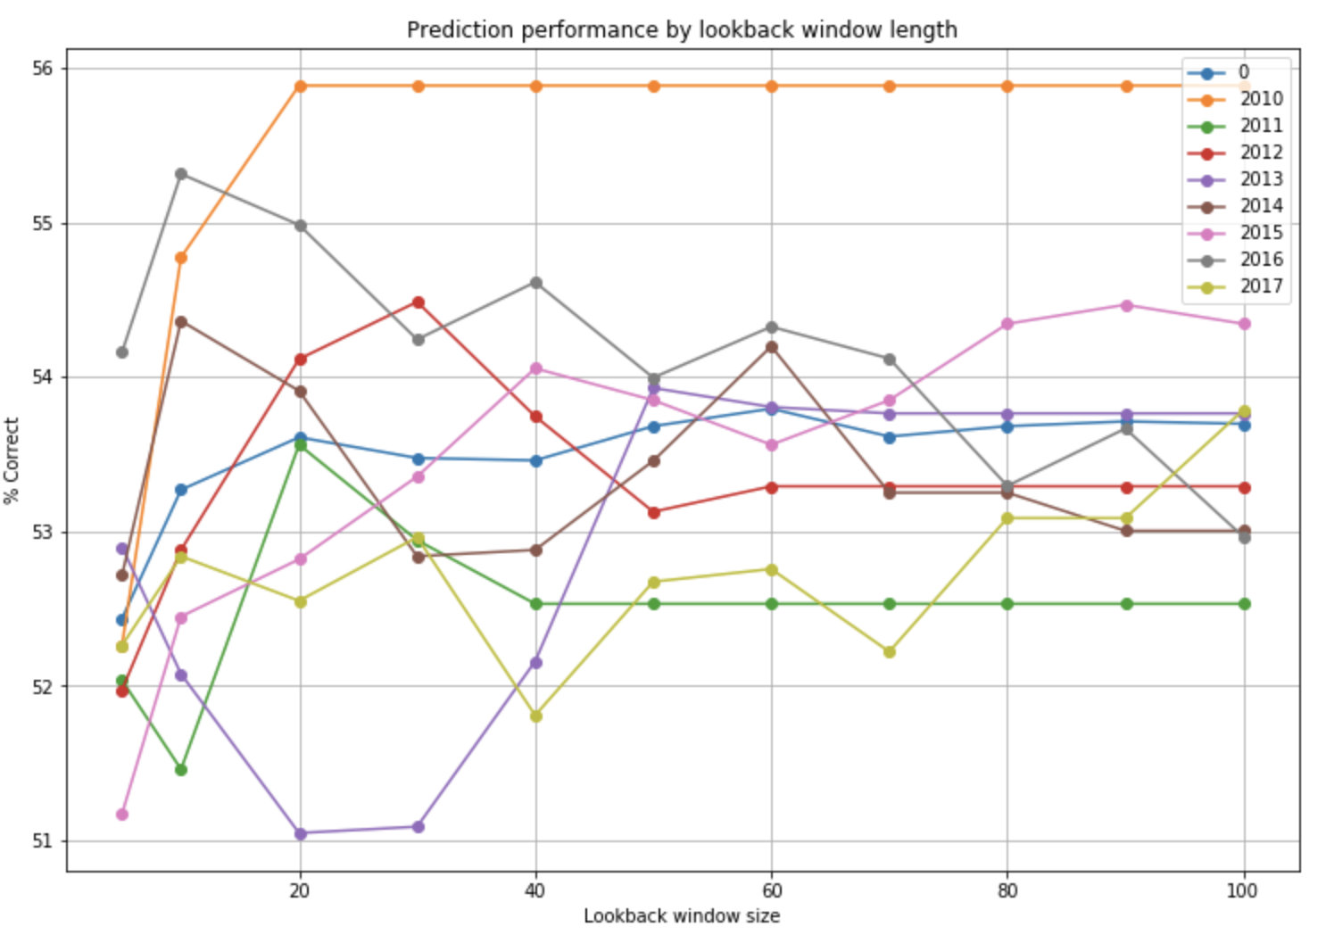
Prediction Performance by Lookback Window Length
game
game
Dataset loaded with 19437 games
2010-04-04 - 2017-10-01 [2010, 2011, 2012, 2013, 2014, 2015, 2016, 2017]
# of games before dropping lookback window: 19437
# of games after dropping lookback window: 17027
slope: 0.474, int: 4.289, r2: 0.503, p-value: 0.0 , std : 0.0036

